Slide 1
The Frequency Domain
EE551
Week 4- Frequency Domain Analysis
Ref. chapter 4 Gonzalez & Woods
2023

Slide 2
In this section…
Introduction to the Frequency (Fourier) domain
Rationale
1-D Fourier Series
2-D Fourier Series
The Fourier Transform
Applications

Slide 3
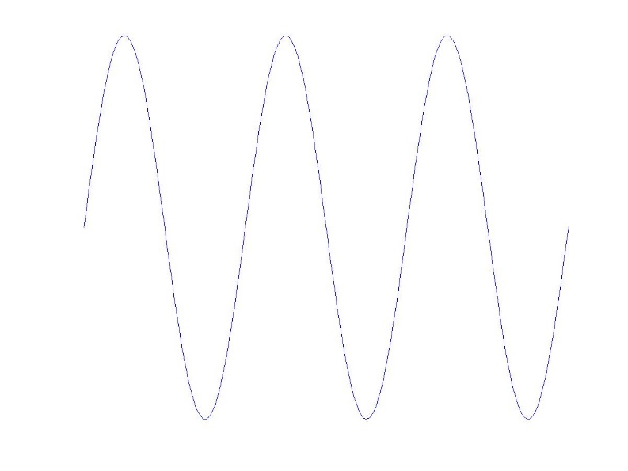
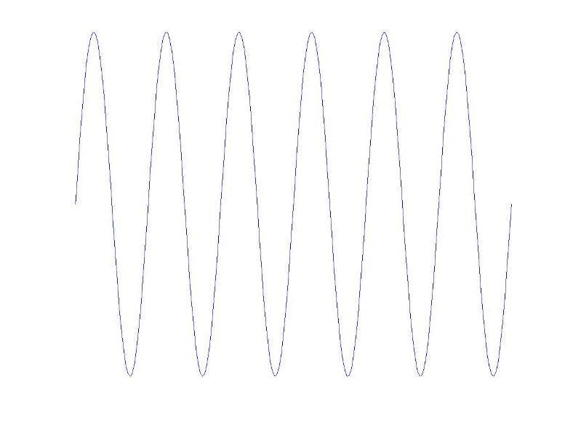
The Fourier (frequency) domain
The central idea of the Fourier representation of an image is that any image may be considered as a superposition/combination of harmonic functions of differing spatial period

Slide 4
Visual examples (https://en.wikipedia.org/wiki/Fourier_series)
Example 1: Fourier Series with 4 terms to approximate a square wave
Example 2: Fourier Series with 4 terms to approximate a sawtooth wave
Example 3: Example of convergence of to a somewhat arbitrary function

Slide 5
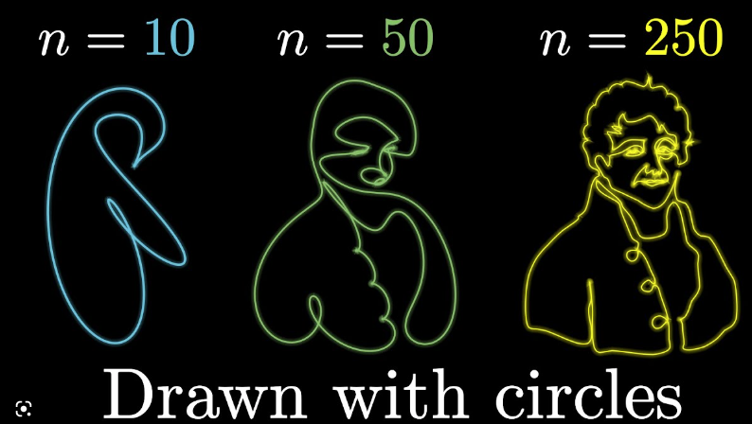
More complex examples
https://www.youtube.com/watch?v=r6sGWTCMz2k

Slide 6
Why Bother? (1)
From the point of view of analysis, sometimes you can see things in the frequency domain that you cannot see in the original signal domain (time or space)
From the point of view of processing, sometimes it’s easier to do something in the frequency domain than in the original signal domain

Slide 7
The Fourier (frequency) domain
We may consider any imaging system or processing operation from the perspective of how it passes, suppresses or removes the constituent harmonic functions.
This is related to the “filtering” behaviour of an imaging system or an image processing algorithm
In our case, we’re going to be primarily interested in using filters to remove noise from images
For periodic functions, we use the Fourier series….

Slide 8
The Fourier series (time)

Slide 9
The Fourier series (space)
Both are referred to as the “spatial frequency”.

Slide 10
Exponential Fourier series (space)
As an alternative to sines and cosines, the Fourier Series may also be expressed in terms of basis functions that are complex exponentials (but are of course related to sines and cosines through Euler’s identities …)

Slide 11
Some comments on Fourier series
The infinite series of harmonic functions in the expansion namely are called the Fourier basis functions.
The coefficients indicate how much of each basis function (i.e. harmonic wave of the given spatial frequency) is required to build f(x). The complete set of coefficients are said to constitute the Fourier spectrum of the spatial function. This is sometimes more loosely called the (spatial) frequency spectrum
To reproduce the original function f(x) exactly, the expansion must extend to an infinite number of terms. In this case , the spatial frequencies and the number of coefficients describing the Fourier spectrum also approach infinity.
Key point The Fourier spectrum is a valid and complete
alternative representation of a function.

Slide 12
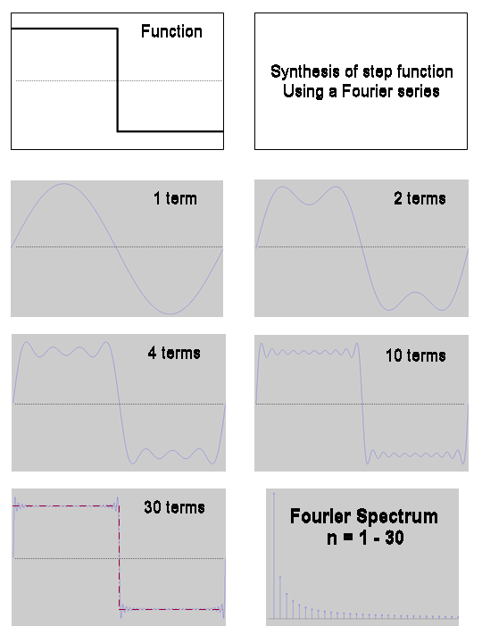
Calculation of the Fourier spectrum
Key Point. In the Fourier representation of a function, high spatial frequencies are needed to construct sharp changes i.e. detail. Low spatial frequencies correspond to the smooth structure.

Slide 13
Calculation of the Fourier spectrum
Representation
Coefficients calculated as -
Calculation

Slide 14
Images in frequency space
Images are not in general periodic.
Images are usually two-dimensional (and sometimes higher-dimensional) functions of finite support
The support of a function is the region over which it is non-zero. Obviously, any real digital image has finite support
It is possible to show that the limit of complex Fourier series as period ➔ infinity is the inverse Fourier transform –

Slide 15
1-D Fourier transform
The 1st expression is the inverse Fourier transform
Thus, in the limit of an infinite spatial period –
The specific weights assigned to the harmonic (complex exponential) functions are given by the function
The frequencies are now continuous and range over all possible values.
The summation for f(x) becomes an integral and the Fourier spectrum is now a function as opposed to a set of discrete values.

Slide 16
1-D Fourier transform
It is vital to emphasize that the essential meaning and purpose of the Fourier transform is really no different from that of the Fourier series. The Fourier transform of a function also fundamentally expresses its decomposition into a weighted set of harmonic functions.

Slide 17
1-D Fourier transform - exercise
What is the Fourier transform of the rectangle function –
What happens as ?

Slide 18
1-D Fourier transform - rectangle function exercise

Slide 19
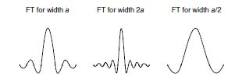
1-D Fourier transform - rectangle function exercise

Slide 20
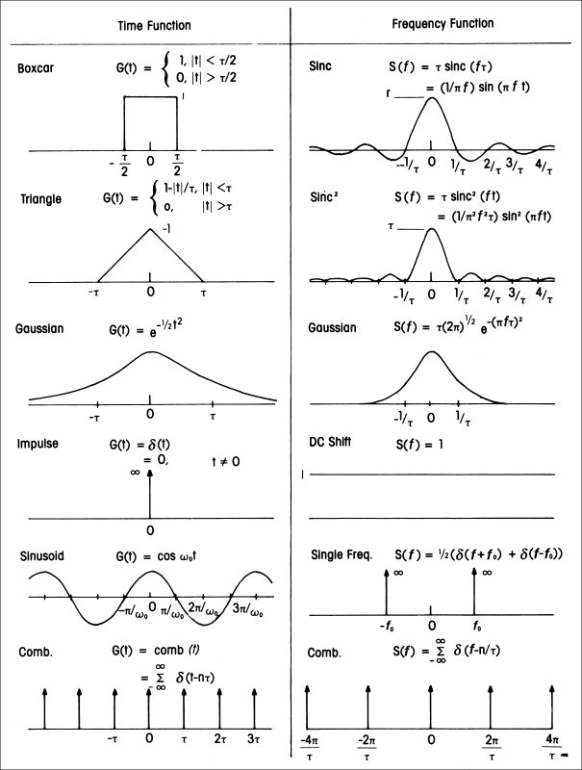
Important Fourier Transforms & Properties

Slide 21
Fourier phase and modulus (“magnitude”)
Remember that the mathematical representation of the Fourier Transform is Really just a complex number so it can be handled just like any other complex number.

Slide 22
The 2-D Fourier transform
INVERSE

Slide 23
Why bother? (2)
The FT says that any input can be decomposed into a linear sum of harmonic functions.
If we know the response of a linear imaging system to any given harmonic function, it follows (by linearity) that we know the response of the system to an arbitrary input function.
Any linear system can be characterized by the degree (greater or less) to which it suppresses the magnitude and/or changes the phase of the component harmonics of an input function.
A system which preserves all the high-frequency components in the input can reproduce all the detail.
The frequency domain representation of a system is the system frequency response
Mathematically, dealing with signals and systems uses the same techniques – what differs is the interpretation of the results

Slide 24
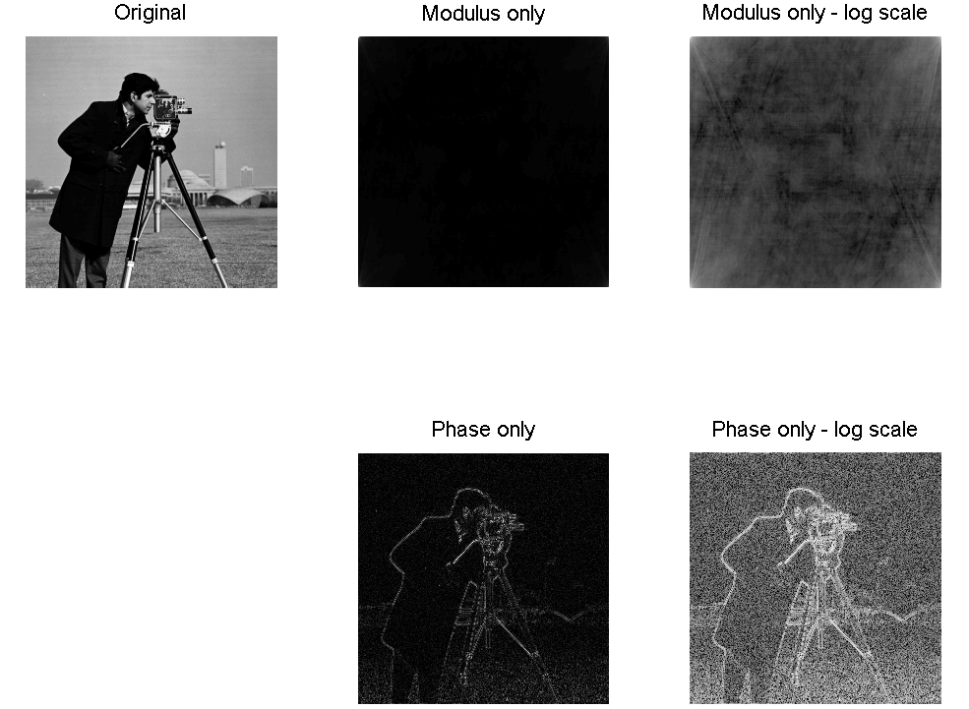
Visual information mainly in the phase
This shows the image being reconstructed by
Setting the Fourier Phase of the image to zero for all components but preserving the modulus
Setting the Fourier modulus of the image to unity for all components but preserving the phase.

Slide 25
The 2-D Fourier transform
INVERSE

Slide 26
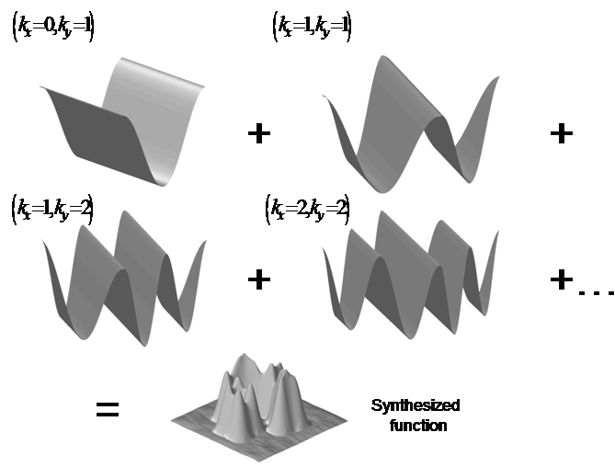
The 2-D Fourier transform
The 2-D Fourier basis functions (2-D harmonic functions of different frequencies)
For convenience, we show only the real part of the basis functions.
The central idea of Fourier analysis is that some scaled and shifted combination of such 2-D basis functions can synthesize an arbitrary 2-D spatial function.

Slide 27
The Discrete Fourier Transform
This discrete transform is also of dimension M x N.
The spatial frequency indices again assume integer values u =0,1,2…M-1,M and v=0,1,2…N-1,N.

Slide 28
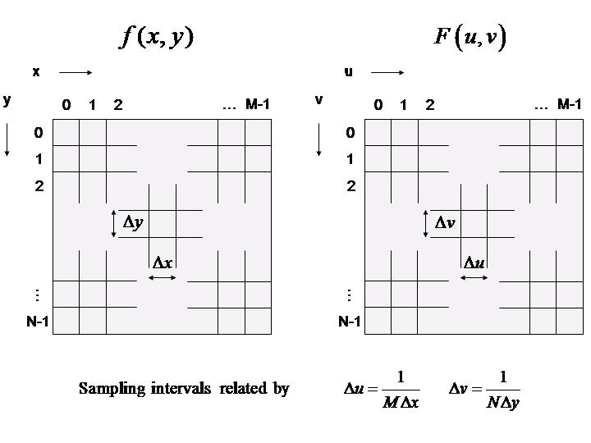
The Discrete Fourier Transform
Sampled image and its discrete Fourier transform (DFT), have the same number of pixels.

Slide 29
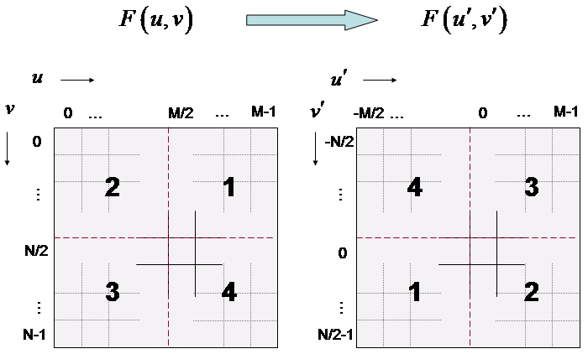
The centred DFT
If F is an M x N array, its centred DFT is given by the DFT of
The centred DFT (right) can be calculated by diagonally swapping the quadrants.
We will assume use of centred DFTs henceforth

Slide 30
The centred DFT
Why centre the DFT ?
You don’t have to but it –
i) makes the form of the discrete Fourier transform much closer to that of the continuous FT.
ii) It makes the design of Fourier domain filters much easier/ more intuitive.

Slide 31
Working with Fourier transforms
Frequency Domain Filtering Operation
Although the maths is arguably a little tough for beginners, using Fourier transforms effectively is surprisingly easy
You Take the FT, adjust the spectrum with a filter function and take the Inverse FT..!
The computational routine known as the Fast Fourier Transform
(FFT) makes this very easy
Fourier Transform
Filter Function H(u,v)
Inverse Fourier Transform
F(u,v)
H(u,v,)F(u,v)
Pre-Processing
Post-processing
f(x,y)
Input image
g(x,y)
Enhanced image

Slide 32
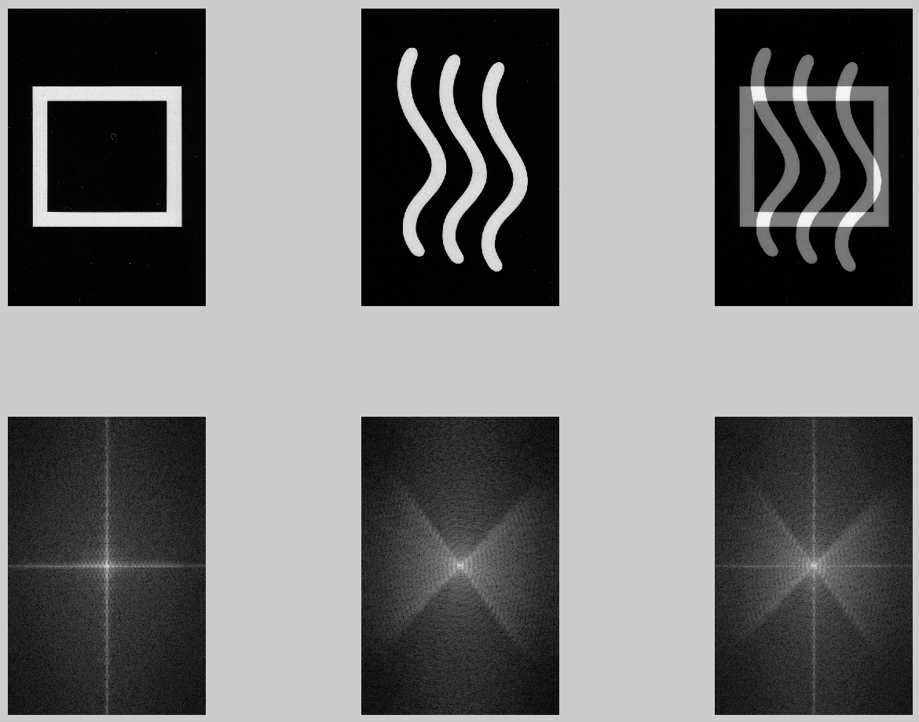
Working with Fourier transforms - some examples
This illustrates
the addition theorem

Slide 33
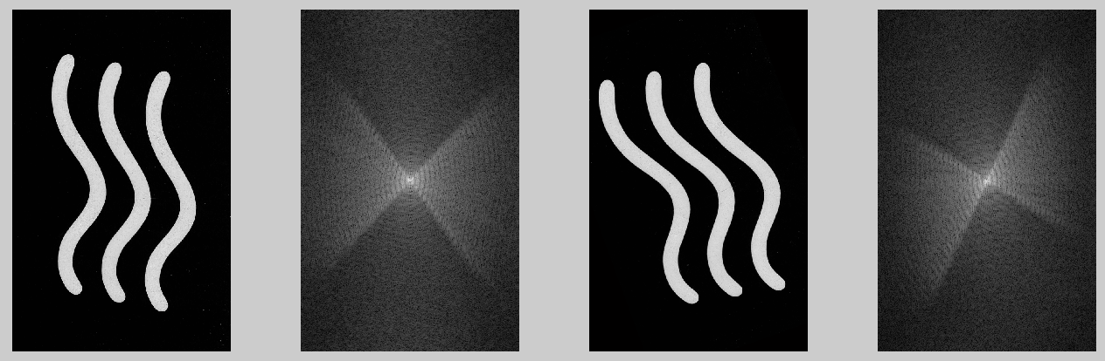
Working with Fourier transforms - some examples
This illustrates
the rotation theorem

Slide 34
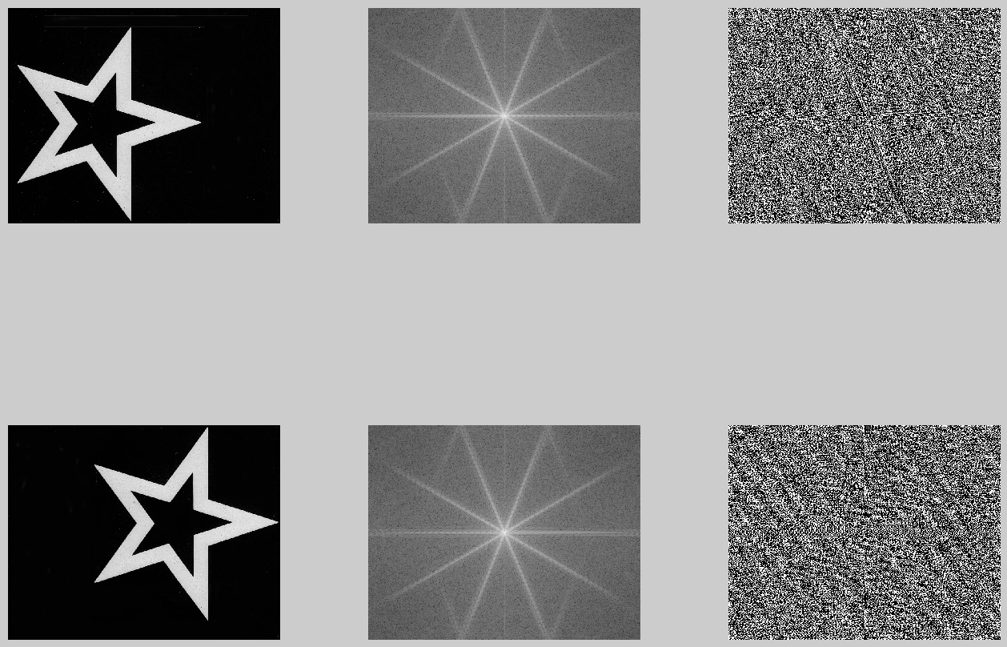
Working with Fourier transforms - some examples
This illustrates
the shift theorem

Slide 35
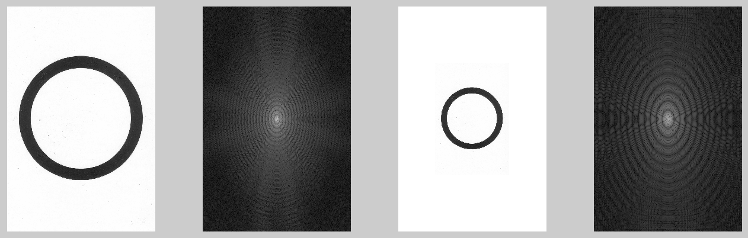
Working with Fourier transforms - some examples
This illustrates
the similarity theorem

Slide 36
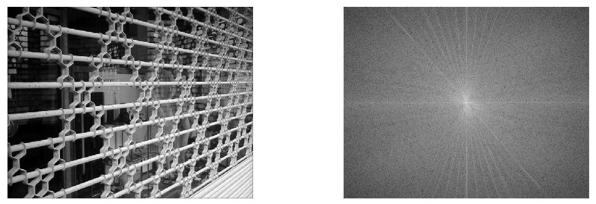
Working with Fourier transforms - some examples
The periodic structure in the image comes through in the appearance of the transform

Slide 37
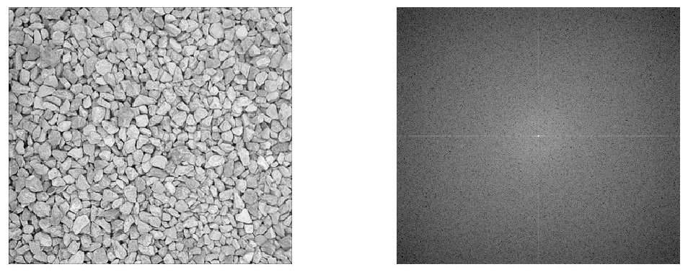
Working with Fourier transforms - some examples
No distinctive frequencies present

Slide 38
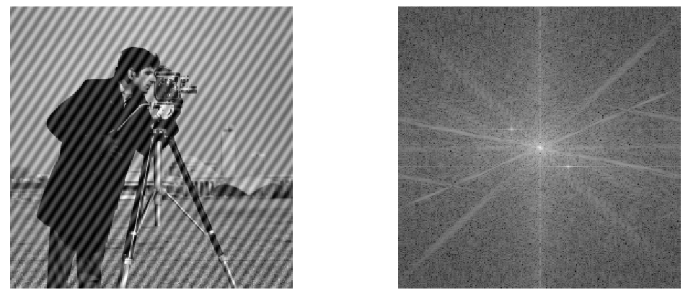
Working with Fourier transforms - some examples
Distinctive frequency of interference signal present

Slide 39

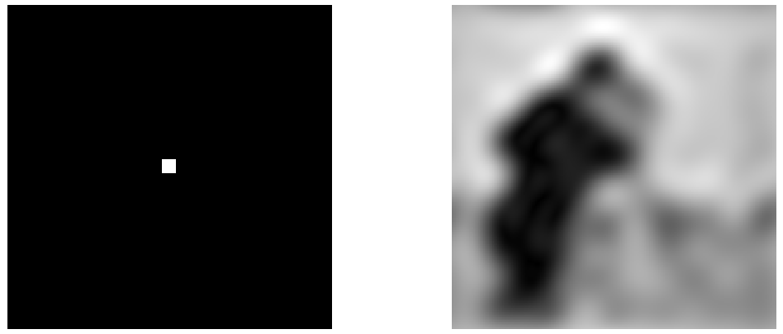
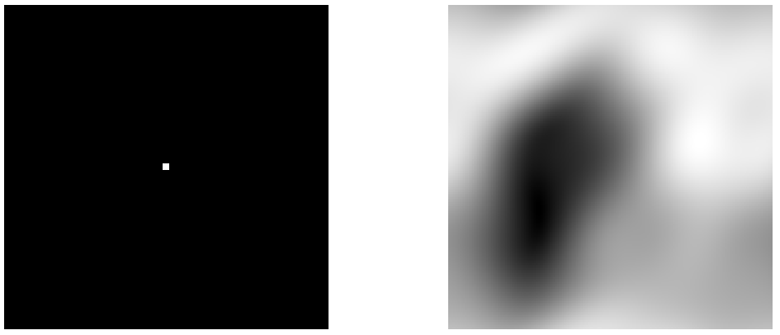
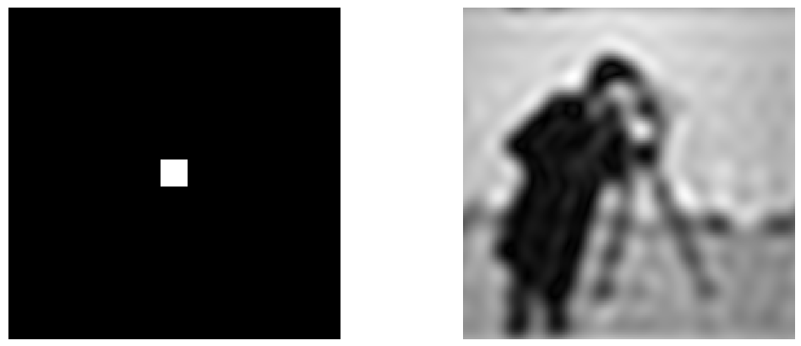
Exploring frequency space
Filter
function
Reconstruction
Filter
function
Reconstruction

Slide 40
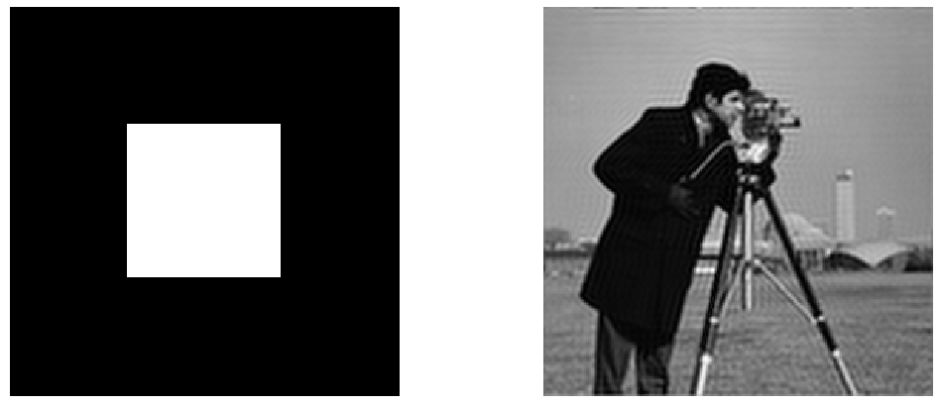
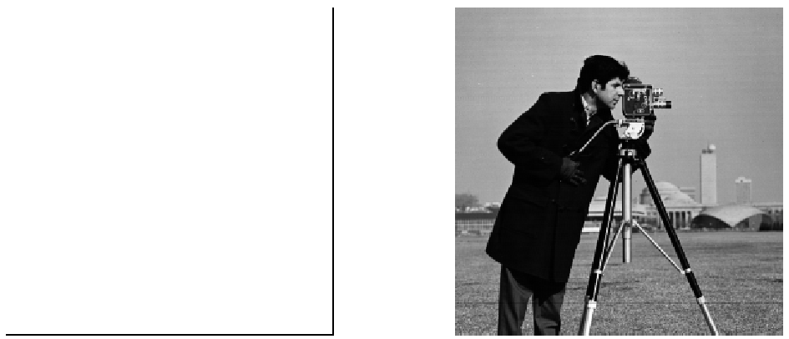
Exploring frequency space
Filter
function
Reconstruction
Filter
function
Reconstruction
Clearly, suppressing high frequencies removes detail from the image

Slide 41
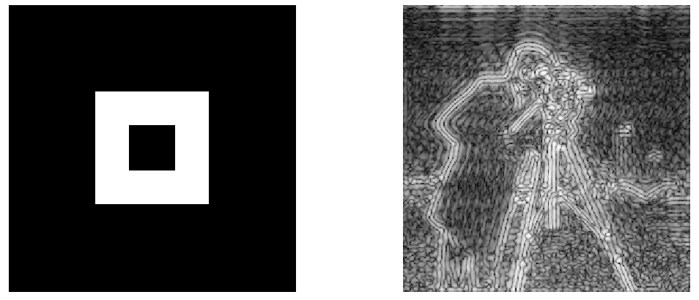

Exploring frequency space
Filter
function
Reconstruction
Filter
function
Reconstruction
These are some band-pass filters and their effect on the images

Slide 42
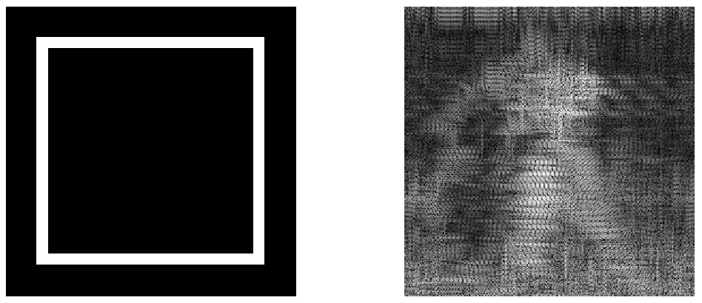
Exploring frequency space
Filter
function
Reconstruction
High band-pass filter

Slide 43
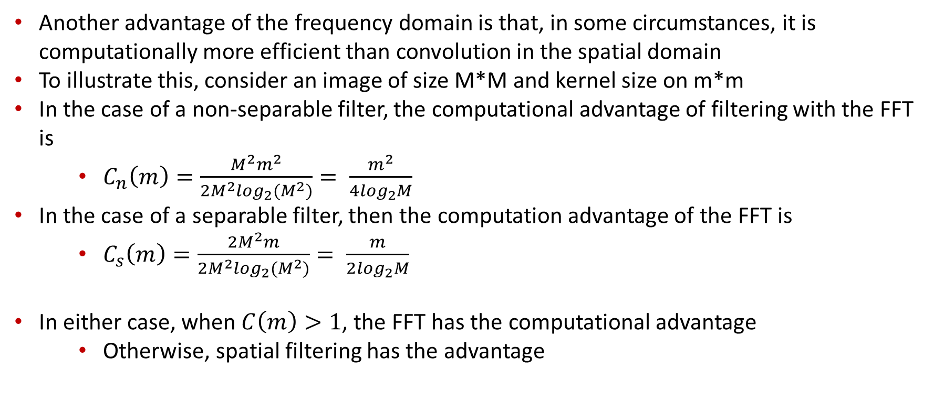
Why bother? (3)
Another advantage of the frequency domain is that, in some circumstances, it is computationally more efficient than convolution in the spatial domain
To illustrate this, consider an image of size M*M and kernel size on m*m
In the case of a non-separable filter, the computational advantage of filtering with the FFT is
$C_{n}\left(m\right)=\frac{M^{2}m^{2}}{2M^{2}\log_{2}(M^{2})}= \frac{m^{2}}{4\log_{2}M}$
In the case of a separable filter, then the computation advantage of the FFT is
$C_{s}\left(m\right)=\frac{2M^{2}m}{2M^{2}\log_{2}(M^{2})}= \frac{m}{2\log_{2}M}$
In either case, when $C\left(m\right)>1$, the FFT has the computational advantage
Otherwise, spatial filtering has the advantage

Slide 44
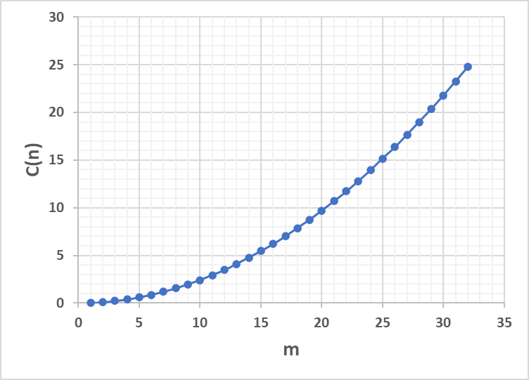
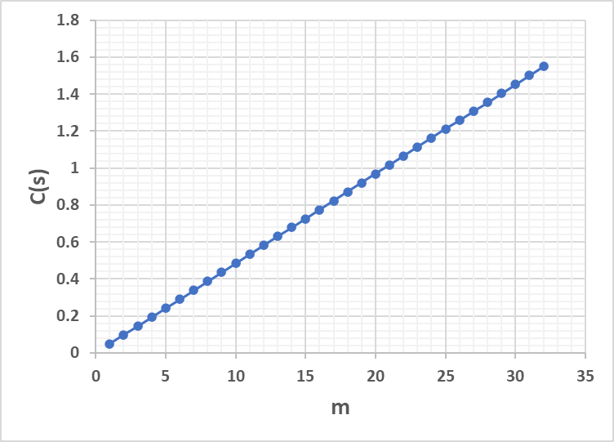
Why bother?(3)
For an image of 1280*1280, FFT is more efficient for a kernel size >6 for non-separable filters,
And a kernel size of >20 for separable filters

Slide 45
Further reading
FFT background info
https://www.youtube.com/watch?v=spUNpyF58BY
https://www.youtube.com/watch?v=r6sGWTCMz2k
Introduction to jpeg compression
https://en.wikipedia.org/wiki/Discrete_cosine_transform
https://www.youtube.com/watch?v=Q2aEzeMDHMA
https://www.youtube.com/watch?v=0me3guauqOU

Slide 46
Questions?

